Slide 1

EDGE COMPUTING SOLUTIONS
Cloudflare
Workers & Snippets
Serverless edge computing for modern web applications
330+ Data Centers
Zero Cold Starts
JavaScript/TypeScript

Slide 2
PRESENTATION OVERVIEW
Contents
01
Cloudflare Workers
02
Workers Example
Serverless edge computing platform overview, architecture, and deployment
Complete working example with code and deployment instructions
03
Cloudflare Snippets
04
Snippets Examples
Lightweight edge logic, specifications, and transformation rules
URL rewriting, header modification, and geolocation redirects
05
Workers vs Snippets Comparison
Feature comparison, use case guidance, and decision framework

Slide 3
CHAPTER 01
Cloudflare
Workers
Serverless Edge Computing Platform
Deploy code globally in seconds

Slide 4
CLOUDFLARE WORKERS
What are Cloudflare Workers?
Serverless Edge Platform
Common Use Cases
Run JavaScript, TypeScript, Python, and Rust across Cloudflare's global network of 330+ data centers without managing infrastructure.
API Gateways
Build and deploy RESTful APIs with automatic scaling
Authentication Layers
Zero Cold Starts
Implement JWT validation, OAuth, and access control
Powered by V8 isolates that start 100x faster than containers, delivering instant responses to users worldwide.
Request Modification
Rewrite URLs, modify headers, and transform requests
Full-Stack Applications
Multiple Languages
Build complete apps with static assets and dynamic logic
Write code in JavaScript, TypeScript, Python, Rust, and more with native framework support for React, Vue, Next.js, and Astro.
100K+
30s
5MB
Free requests/day
Max execution time
Package size limit

Slide 5
ARCHITECTURE
How Workers Work
1
V8 Isolates
2
Per-Request Compute
3
Global Distribution
Workers run on V8 isolates—lightweight sandboxes that provide secure code execution without the overhead of containers.
Each incoming HTTP request invokes the fetch() handler, with code executing only for the duration of that request.
Code deploys to all 330+ Cloudflare data centers, executing closest to the user for minimal latency.
100x faster startup than containers
Event-driven execution model
Automatic geo-distribution
Memory-isolated execution
Automatic resource allocation
Edge-optimized execution
Thousands per runtime instance
No idle resource consumption
Single command deployment
Basic Worker Structure
export default {
async fetch(request, env, ctx) {
// request: Incoming HTTP request// env: Environment variables & bindings// ctx: Execution context (waitUntil, passThroughOnException)return newResponse('Hello World!');
}
};

Slide 6
HANDS-ON EXAMPLE
Workers: Simple Example
A complete API endpoint with routing and JSON responses
Worker Code (index.js)
Deployment Commands
export default {
async fetch(request, env, ctx) {
const url = newURL(request.url);
const path = url.pathname;
// Route: /api/helloif (path === '/api/hello') {
return newResponse(
JSON.stringify({
message: 'Hello from Cloudflare Workers!',
timestamp: newDate().toISOString(),
region: request.cf.colo
}), {
headers: { 'Content-Type': 'application/json' }
}
);
}
// Route: /api/healthif (path === '/api/health') {
return newResponse(
JSON.stringify({ status: 'ok' }),
{ headers: { 'Content-Type': 'application/json' } }
);
}
// Default: 404 Not Foundreturn newResponse('Not Found', {
status: 404
});
}
};
# Create new Worker project
npm create cloudflare@latest my-api
# Navigate and develop locally
cd my-api && npx wrangler dev
# Deploy to production
npx wrangler deploy
Key Features Demonstrated
URL Routing: Parse request URL and route to different handlers
JSON Responses: Return structured data with proper headers
CF Object: Access Cloudflare-specific data (colo, country, etc.)
Error Handling: Return appropriate HTTP status codes
Try it: Deploy and visit /api/hello to see the response

Slide 7
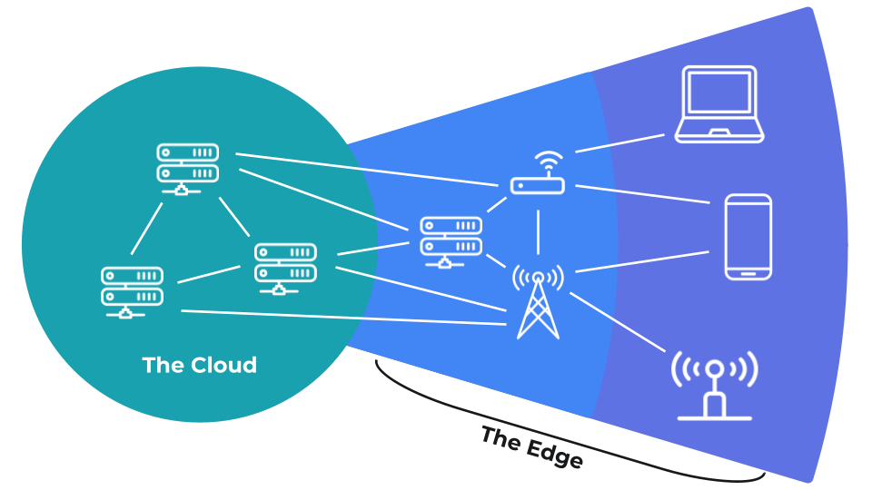
CHAPTER 02
Cloudflare
Snippets
Lightweight Edge Logic with JavaScript
Fast, flexible, and free traffic modifications

Slide 8
CLOUDFLARE SNIPPETS
What are Cloudflare Snippets?
Code-Based Rules
Key Capabilities
Snippets bring JavaScript power to Cloudflare Rules, allowing custom logic for HTTP modifications without a full Workers setup.
Header Modification
Dynamically add, remove, or modify HTTP headers
URL Rewriting
Ultra-Fast Execution
Transform paths and query strings dynamically
Optimized for speed with 5ms max execution time. Powered by Ruleset Engine and Workers runtime for edge performance.
Redirects & Routing
Implement complex redirects and traffic routing
JWT Validation
No Additional Cost
Validate authentication tokens at the edge
Included free on all paid plans (Pro, Business, Enterprise). No usage-based billing—unlimited invocations within limits.
Execution Order: Snippets run before Workers, allowing preprocessing

Slide 9
TECHNICAL SPECIFICATIONS
Snippets: Limits & Specifications
Resource Limits
Supported APIs
Max Execution Time
5 ms
Fetch API
Make HTTP requests to origins or external services
Cache API
Memory Limit
2 MB
Interact with Cloudflare's edge cache
request.cf Object
Package Size
32 KB
Access Cloudflare properties (country, colo, bot score)
HTMLRewriter
Parse and transform HTML responses

Slide 10
TRANSFORMATION CAPABILITIES
Snippets Transformation Rules
Three main types of HTTP traffic modifications
URL Rewrite
Request Headers
Response Headers
Modify the URL path and query string of HTTP requests dynamically using JavaScript logic.
Set, modify, or remove HTTP request headers before they reach your origin server.
Set, modify, or remove HTTP response headers before they reach the website visitor.
Rewrite paths based on conditions
Add authentication tokens
Set cookies dynamically
Modify query parameters
Modify X-Forwarded headers
Add security headers
Dynamic URL construction
Set custom request identifiers
Modify cache-control headers
Use Case Example:
Use Case Example:
Use Case Example:
Add UTM parameters for social media traffic
Add bot score headers for origin processing
Set A/B testing cookies with expiry
Key Advantage: Snippets extend beyond built-in Transform Rules, enabling complex logic like dynamic calculations, conditional transformations, and JavaScript-powered modifications.

Slide 11
SNIPPETS EXAMPLE
Geolocation-Based Redirects
Route users to country-specific website versions
Snippet Code
request.cf Properties
export default {
async fetch(request) {
// Access Cloudflare geolocation dataconst country = request.cf.country;
const continent = request.cf.continent;
// Define country-to-URL mappingconst redirectMap = {
'US': 'https://example.com/us',
'GB': 'https://example.com/uk',
'DE': 'https://example.com/de',
'FR': 'https://example.com/fr',
'JP': 'https://example.com/jp',
'AU': 'https://example.com/au'
};
// Define continent fallback mappingconst continentMap = {
'EU': 'https://example.com/eu',
'AS': 'https://example.com/asia'
};
// Check for country-specific redirectif (redirectMap[country]) {
returnResponse.redirect(
redirectMap[country],
301
);
}
// Fallback to continent-specific redirectif (continentMap[continent]) {
returnResponse.redirect(
continentMap[continent],
301
);
}
// No match - proceed to originreturn fetch(request);
}
};
request.cf.country
"US", "GB", "DE"
request.cf.continent
"NA", "EU", "AS"
request.cf.city
"San Francisco"
request.cf.colo
"SJC" (airport code)
Redirect Logic Flow
1
Check country code match
2
If no match, check continent
3
If no match, proceed to origin
Result: Users automatically see localized content

Slide 12
PRODUCT COMPARISON
Workers vs Snippets
Choose the right tool for your edge computing needs
Feature
Workers
Snippets
Execution Time
30s (HTTP) / 15min (Cron)
5 ms
Memory Limit
128 MB
2 MB
Package Size
5 MB
32 KB
Languages
JS, TS, Python, Rust, WASM
JavaScript only
State Management
KV, D1, Durable Objects
Not supported
Deployment
Wrangler CLI, API
Dashboard, API, Terraform
Pricing
Usage-based ($5/mo + usage)
Free on paid plans
Request Matching
URL routes only
Ruleset Engine filters
Use Workers When:
Use Snippets When:
Building APIs, full-stack apps, need state/storage, complex compute, or advanced features
Modifying headers/URLs, simple redirects, lightweight logic, or when you need free unlimited invocations
Observability
Logs, analytics, tracing
Limited
Best For
Full-stack apps, APIs, complex logic
Header mods, redirects, rewrites

